Slide 1
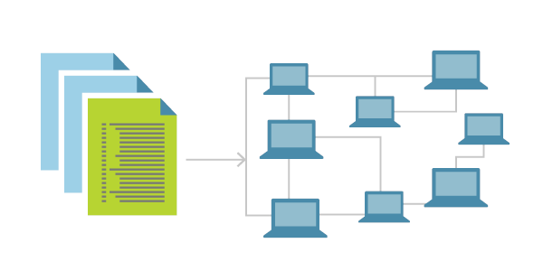

An Introduction to: Infrastructure as Code
Sam Cogan
Solution Architect, Willis Towers Watson & Microsoft MVP

Slide 2


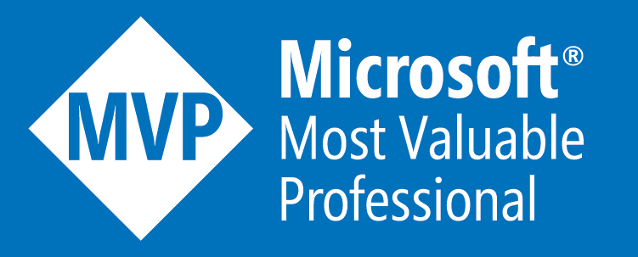


About Me
Sam Cogan
Solution Architect – Willis Towers Watson
Microsoft Azure MVP
samcogan.com
@samcogan
sam-cogan

Slide 3
What is Infrastructure as Code?
“Provisioning resources using machine-readable definitions rather than iterative configuration tools.”
Notes:
FunctionExamples.json – UniqueString, ResourceGroup, ListKeys, toLower
SaSToken.json – generating a SAS token with ListKeys
Mod.json – using mod to alternate between storage accounts

Slide 4
What is Infrastructure as Code?
Declarative
Idempotent/Repeatable
Immutable
Reusable
Modular
Drift Correction
Notes:
FunctionExamples.json – UniqueString, ResourceGroup, ListKeys, toLower
SaSToken.json – generating a SAS token with ListKeys
Mod.json – using mod to alternate between storage accounts

Slide 5
What is Infrastructure as Code?
Declarative
Idempotent/Repeatable
Immutable
Reusable
Modular
Drift Correction
Notes:
FunctionExamples.json – UniqueString, ResourceGroup, ListKeys, toLower
SaSToken.json – generating a SAS token with ListKeys
Mod.json – using mod to alternate between storage accounts

Slide 6
Benefits
Consistency
Speed
Versioning
Accountability & Change Management
Scalability
Testing
Documentation
Collaboration
Notes:
FunctionExamples.json – UniqueString, ResourceGroup, ListKeys, toLower
SaSToken.json – generating a SAS token with ListKeys
Mod.json – using mod to alternate between storage accounts

Slide 7









Infrastructure as Code
!=
Configuration Management as Code
Notes:
FunctionExamples.json – UniqueString, ResourceGroup, ListKeys, toLower
SaSToken.json – generating a SAS token with ListKeys
Mod.json – using mod to alternate between storage accounts

Slide 8
Demo
Create a Storage Account with an ARM Template

Slide 9
IaC Tooling – Cloud Vendors
Cloud Formation/CDK
ARM Templates
Deployment Manager
Positives
Direct from Cloud Provider
Supported by Cloud Provider
Will get the latest updates fastest
Stateless
Negatives
Single Cloud
Stateless
Closed Source
Notes:
FunctionExamples.json – UniqueString, ResourceGroup, ListKeys, toLower
SaSToken.json – generating a SAS token with ListKeys
Mod.json – using mod to alternate between storage accounts

Slide 10
IaC Tooling – Third Parties
Terraform
Pulumi
Positives
Multi Cloud Support
Non Cloud Support
Stateful – Plan, Destroy, Import
Open Source
Negatives
Delayed implementation of new resources
Management of State File
Third Party Support
Cost
Notes:
FunctionExamples.json – UniqueString, ResourceGroup, ListKeys, toLower
SaSToken.json – generating a SAS token with ListKeys
Mod.json – using mod to alternate between storage accounts

Slide 11
IaC Tooling Comparison
 | CloudFormation | ARM Templates | Deployment Manager | Terraform | Pulumi
Languages | YAML/JSON CDK Support for TS, JS, JAVA, .NET, Python | JSON | Jinja/Python | Custom DSL (HCL) | Node JS (TS, JS), Python, .NET Core, GO
Speed Of Update | Fast | Fast | Fast | Slower | Slower
Multi Cloud | No | No | No | Yes | Yes
Stateful | No | No | No | Yes | Yes
Open Source | CDK | No | No | Yes | Yes
Support | Cloud Provider | Cloud Provider | Cloud Provider | Community/Paid | Community/Paid
Additional Features | Policy (separate service) | Policy (separate service) |  | Cloud State Policy & Governance Module Repository Web Portal Cost Estimation | Cloud State Policy & Governance Web Portal
Notes:
FunctionExamples.json – UniqueString, ResourceGroup, ListKeys, toLower
SaSToken.json – generating a SAS token with ListKeys
Mod.json – using mod to alternate between storage accounts

Slide 12

Demo
Create a Storage Account with an Terraform & Pulumi

Slide 13
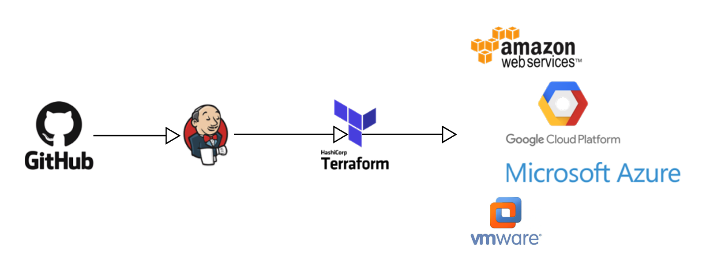
Infrastructure as Code is Code!
IDE’s and Tooling
Version Control
Testing
CI/CD
Notes:
FunctionExamples.json – UniqueString, ResourceGroup, ListKeys, toLower
SaSToken.json – generating a SAS token with ListKeys
Mod.json – using mod to alternate between storage accounts

Slide 14

Demo
Development Tools

Slide 15
Getting Started
Try out tools and see what works for you
Start with a small, contained unit of work
Iterate
Don’t do it in production!
Keep templates focussed – lower the blast area!
Store your code in version control
When your ready, look at CI/CD
Notes:
FunctionExamples.json – UniqueString, ResourceGroup, ListKeys, toLower
SaSToken.json – generating a SAS token with ListKeys
Mod.json – using mod to alternate between storage accounts

Slide 16

Slides and Demos
https://cogan.to/f427c

Slide 17
About Me
Sam Cogan
Solution Architect – Willis Towers Watson
Microsoft Azure MVP
samcogan.com
@samcogan
sam-cogan

